Slide 1

Compliance & Testing Services
Leather, Leather Products & footwear Supply chain
26th August , 2021

Slide 2
Agenda
Part |  | Topic
1 |  | TÜV Rheinland- International Existence & Importance
2 |  | EU REACH REGULATION
3 |  | Chemical & Waste Water Management
4 |  | BIS – Footwear, Toys; New Era of Product Certification in India
5 |  | Q&A

Slide 3
TÜV Rheinland- International Existence & Importance

Slide 4


Our Motivation : Weaving a safe future
We continuously strive to ensure the safety, quality, and economic efficiency of the interaction between People, technology and the environment. This philosophy is embodied in our triangular logo.
We are committed to the principles of the UN Global Compact.
Human rights
Labor standards
Environmental protection
Fighting corruption
People
Technology
Environment

Slide 5


Softlines.
We offer neutral and independent support and fundamental specialist knowledge in detecting and evaluating harmful materials and hazardous substances, performance and safety in all kinds of textile products
Apparel
Leather and Footwear
Home textiles
Toys
Candle and Candle Holders
Jewelry
Fashion Accessories
Food contact materials
DETOX Waste Water testing

Slide 6










Softlines Laboratories Network
Shanghai
Shenzhen
Ningbo
Hong kong
Thailand
Vietnam
Turkey
Bangladesh
India x3
US
Germany x 2

Slide 7



Testing Standards
EN, ISO
DIN
Germany
Europe
CAN
AATCC, ASTM
Canada
USA
AS
BS
Australia
United Kingdom
JIS
GB
Japan
China
SASO
IS
Japan
Saudi Arabia
India

Slide 8

Footwear & Leather Testing Services – Highlights
Physical Testing parameters
Color Fastness Parameters : Colorfastness to Rubbing , Color fastness to Perspiration, Color fastness to Water
Functional testing Parameters : Water Penetration Test , Water Vapour Absorption, Water Vapour Permeability.
Footwear/Leather testing Parameters : Slip Resistance , Abrasion Resistance-Sole ( Drum) , Top Piece Attachment Strength, Heel Impact Resistance , Vamp Flexing , Adhesion of finish, Velcro Peel and Shear Strength , Abrasion Resistance of Leather, Eyelet Attachment Strength , Ross Flexing, Breaking strength of Shoe Lace, Toe Post Strength etc.
Chemical Testing Parameters
- Short chain chlorinated paraffin's , Azo , Lead in Surface Coating / Lead in Substrate, Phthalates , Chromium VI etc.

Slide 9

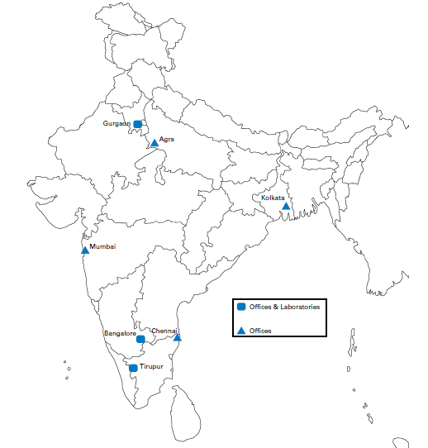
TÜV Rheinland India – Our Soft lines Network.
Gurgaon
Noida
Three laboratories across India
  Gurgaon,
  Bangalore
  Tirupur
Visakhapatnam
Tirupur
Kochi

Slide 10

Technical Training – EU REACH
Regulation (EC) No 1907/2006

Slide 11
Technical training – REACH Regulation
REACH - Introduction
REACH (EC) 1907/2006 is the European Regulation on Registration, Evaluation, Authorisation and Restriction of Chemicals.
It entered into force in 2007, replacing the former legislative framework for chemicals in the EU.
Goals:
ensure a high level of protection for human health and the environment through the better and earlier identification of the intrinsic properties of chemical substances.
Regulation sets rules for the EU, ensuring free circulation of substances on the internal market and the enhancement of competitiveness and innovation
promotion of alternative test methods
The European Commission plays a key role in implementing REACH legislation
The Commission works closely with the European Chemicals Agency (ECHA) in the implementation of the REACH Regulation.

Slide 12
Technical training – REACH Regulation
REACH - introduction
The Agency (“ECHA”) acts as the central point in the REACH system:
it manages the databases necessary to operate the system,
co-ordinates the in-depth evaluation of suspicious chemicals and
is building up a public database in which consumers and professionals can find hazard information.
REACH not only has an impact on chemical industry, it requires good communication along the supply chain.
The Regulation also calls for the progressive substitution of the most dangerous chemicals (Substances of very high concern) when suitable alternatives have been identified.

Slide 13
Technical training – REACH Regulation
REACH - Introduction
REACH (EC) 1907/2006
Before REACH was adopted a large number of substances have been manufactured and placed on the market in Europe without having sufficient information on the hazards that they pose to human health and the environment. It has been agreed to that there is a need to fill these information gaps to ensure that industry is able to assess hazards and risks of the substances, and to identify and implement the risk management measures to protect humans and the environment.
No data, no market
Article 5: No data, no market
Subject to Articles 6, 7, 21 and 23, substances on their own, in mixtures or in articles shall not be manufactured in the Community or placed on the market unless they have been registered in accordance with the relevant provisions of this title where this is required

Slide 14
Technical training – REACH Regulation
REACH - Introduction
REACH shifts the responsibility from public authorities to industry with regards to
Assessing and managing the risks posed by chemicals and
Providing appropriate safety information for their users
EU wants to know more about substances that are imported and manufactured in the EU
Companies manufacturing and importing chemicals in the EU/EEA are responsible for the safe use of their products
Manufacturers and importers are required to gather information (“technical dossier”) on the properties of their chemical substances
Manufactuers and importers need to register the information in a central database run by the European Chemicals Agency (ECHA) in Helsinki.
The Agency acts as the central point in the REACH system
Importer has to be located in the EU (or select “only representative” in the EU)

Slide 15
Technical training – REACH Regulation
REACH Introduction – No data, no market
No data, no market – Article 5 of REACH Regulation
Companies, importers and manufacturer must register chemicals with the ECHA (ECHA will put it into a central database) when substance is manufactured or imported in quantities of 1 ton per year ("No data, no market").
This requirement is applicable to substances and to the mixtures containing them. Manufacturers and importers must collect and provide information related to
- the identity of the substance,
- its physico-chemical properties,
-- its toxicity,
- its ecotoxicity (i.e. its effect on the ecosystem)
- its environmental characteristics (degradation etc.)
- its use and its production.

Slide 16
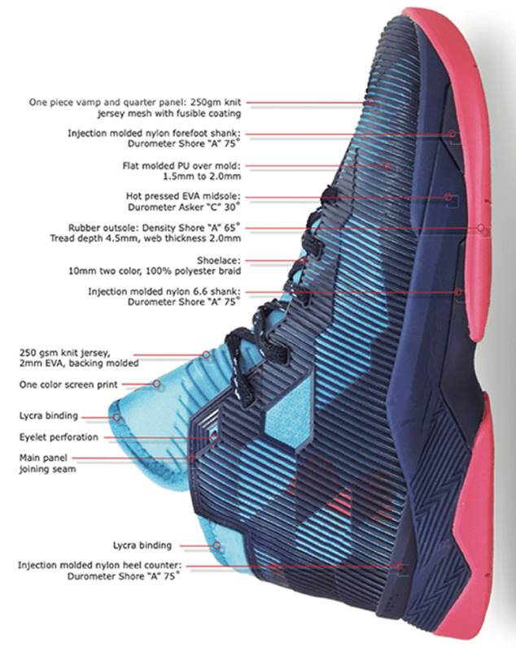
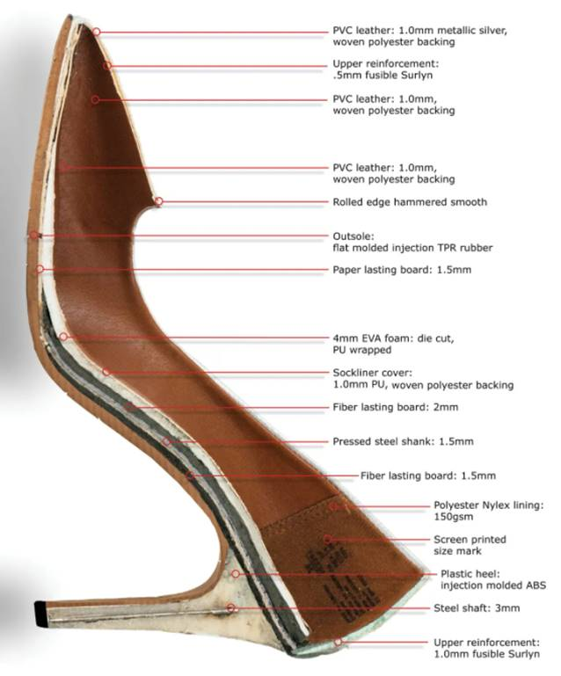
Technical training – REACH Regulation
What is REACH – terms and definition
Article:
An object which during production is given a special shape, surface or design which determines its function to a greater degree than does its chemical composition.
Example: Cup is used for drink liquids, regardless of material used. wheel for remote controlled car has to be round
Substance
Mixture

Slide 17
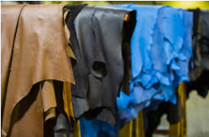

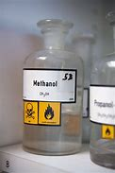


Technical training – REACH Regulation
What is REACH – terms and definition
Article:
Substance:
A chemical element and its compounds in the natural state or obtained by any manufacturing process, Examples: metals (copper), dyes (azo dye), solvents (methanol)
Mixture

Slide 18
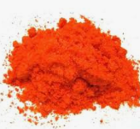
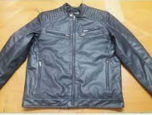

Technical training – REACH Regulation
What is REACH – terms and definition
Article:
Substance:
Mixture: A mixture or solution composed of two or more substances.

Slide 19
Technical training – REACH Regulation
REACH's effect on companies
Under REACH companies may have one of these roles:
Manufacturer: If you make chemicals, either to use yourself or to supply to other people (even if it is for export), then you will probably have some important responsibilities under REACH.
Importer: If you buy anything from outside the EU/EEA, you are likely to have some responsibilities under REACH. It may be individual chemicals, mixtures for onwards sale or finished products, like clothes, furniture or plastic goods.
Downstream users: Most companies use chemicals, sometimes even without realising it, therefore you need to check your obligations if you handle any chemicals in your industrial or professional activity. You might have some responsibilities under REACH.
Companies established outside the EU: If you are a company established outside the EU, you are not bound by the obligations of REACH, even if you export theiR products into the customs territory of the European Union. The responsibility for fulfilling the requirements of REACH, such as registration lies with the importers established in the European Union, or with the only representative of a non-EU manufacturer established in the European Union.

Slide 20







Technical training – REACH Regulation
Border of the EU market
Duties according to your role
Importer
Manufacture / Producer
Manufactuerer / Producer
Downstream user
Downstream User
Händler
Only
Representative
… Substance
Preparation / mixture
Article
Consumerr

Slide 21
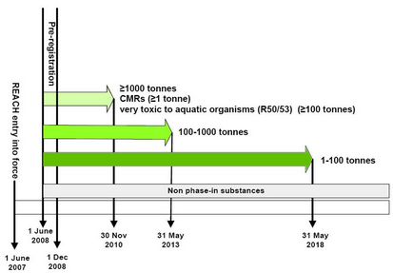
Technical Training – REACH Regulation
Duties according to your role
REACH requires all companies manufacturing or placing a substance on the EU market in quantities greater than 1t/year to register that substance with the European Chemicals Agency (ECHA).
Deadlines for registration depend on tonnage of substance
Registration dossier has to be in IUCLID format
IUCLID: Software to record, store, maintain and exchange data on intrinsic and hazard properties of chemical substances
ECHA and OECD developed this software, use is free of charge

Slide 22
Legal requirement according to REACH Regulation
The obligation of producer / importer
Case | SVHC concentration | Quantity per year | obligation | To | Regulation
Article contains SVHC | > 0.1% (w/w) | > 1 t | Notification | ECHA | Article 7 (2)
 |  | - | Communication for safe use | Buyer (in the supply chain) | Article 33
 |  | - | Provide SVHC information | Consumer (respond in 45 days when requested) | Article 33
 |  | - | Notify in SCIP database | ECHA | Waste Framework Directive
 | < 0.1% (w/w) | - | No | - | -
Mixture contains SVHC Non-gaseous | > 0.1% (w/w) | - | Reflect the SVHC information in SDS | Buyer (in the supply chain) | Article 31

Slide 23
REACH Obligations Overview at Different Object Levels
Substance, Preparation
Is it comply EU Mandatory Chemical requirements ?? (Annex XVII of REACH)
Article
With Preparations?
(or intended release substances)?
Yes
Yes
No
No
Restriction:
PASS
Within the preparation /
Intended release substances
Each chemical……
Within the article part,
Any SVHC?
No
Restriction:
FAIL
Yes
In the substance /
preparation,
Any SVHC?
Is the SVHC in an
Article >0.1% ?
No Further
Action
Yes
No
Yes
No
Each substance Import to EU
>1 ton p.a. ?
That particular SVHC import
To EU >1 ton p.a. ?
No Further
Action
Provide Safety
Data Sheet
No Further
Action
Yes
No
Yes
No
Apply Authorisation,
if presence of SVHC
in Annex XIV >0.1%
Substance
Registration is
required
No Further
Action
Notification
Is required
Provide chemical information
To consumers within 45 days of the receipt of this request

Slide 24
Technical training – REACH Regulation
REACH – Candidate list
Candidate list also known as Substances of very high concern
SVHC are CMR substances or (very) toxic, (very) persistent, (very) bioaccumulative or have endocrine properties
Member states propose substances to be added to that list
ECHA will collect comments from interested parties
Proposed substance can be added to the SVHC list which will lead to several duties according to article 33
Biannual proposing
Biannual update of candidate list, currently 219 substances listed, https://www.echa.europa.eu/candidate-list-table

Slide 25
3. Candidate List
The identification of SVHC
Reason for inclusion (in accordance to CLP regulation):
Article 57(a) - carcinogenic category 1A or 1B;
Article 57(b) - mutagenic category 1A or 1B;
Article 57(c) - toxic for reproduction category 1A or 1B;
Article 57(d) - persistent, bioaccumulative and toxic (PBT);
Article 57(e) - very persistent and very bioaccumulative (vPvB);
Article 57(f) - equivalent level of concern having probable serious effects to human health (and/or) the environment.
Consultation of the substances:
twice / year, 45 days
Up to now 219 substances (latest updated on July. 8th, 2021)
https://echa.europa.eu/candidate-list-table
6 months “transition period” after inclusion

Slide 26
Technical training – REACH Regulation
REACH – Candidate list
Once a substance is added to the Candidate list this brings new duties to supplier of this substance
Article 33 – Information duty, need to inform downstream users (receiver of the article)
Article 33 - Consumers (general public) can request information on products, 45 days time to answer, free of charge
Notification to ECHA if SVHC is present in concentration >0,1% and total amount imported to EU is 1t per year (article 7(2))
Required information:
the identity and contact details of your company
the identity of the substance and its registration number, if available
the tonnage range of the substance in the notified article(s)
a brief description of the use(s) of the substance in the article(s) and of the uses of the article(s)
Transition period for information duty: 6 months after inclusion in candidate list
Apps to enforce information duty, example: ToxFox

Slide 27

Technical training – REACH Regulation
REACH – Candidate list
ToxFox: A consumer scans a product’s barcode, app sends an email to the manufacturer asking them to provide information about SVHCs
Article 33 of REACH: Right to know. Manufactur has to reply within 45 days, providing following information:
Name of the substance
Concentration of this substance
Guidance about safe use of the article

Slide 28
Technical training – REACH Regulation
REACH – Annex XIV, Authorisation list
ECHA assesses the substances from the Candidate List to determine which ones should be included in the Authorisation List (Annex XIV of REACH Regulation) at least every two years
When substance is added sunset date and latest application date are added
Sunset date: no placing on the market and no use of this substance after that date – unless you have authorization for exemption
Latest application date – Apply for exemption before that date to ensure decision is made before sunset date
Imported products are excluded
No use of DEHP in EU – not present in products produced in EU. Can be present in imported goods (information duty applies)
Imported preparations are in scope: DEHP cannot be present in preparations (candles, paint…)
https://www.echa.europa.eu/web/guest/authorisation-list

Slide 29


Chemical & Waste Water Management

Slide 30


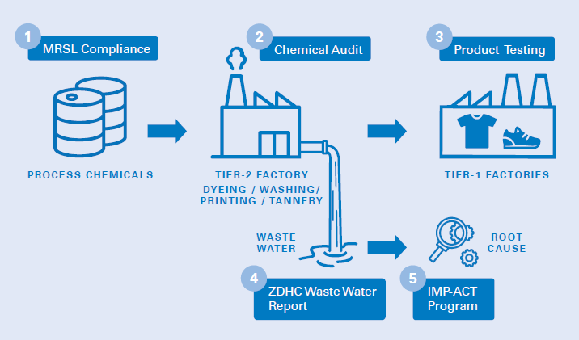




Engagement across supply chain
www.tuv.com/detox
Notes:
The case studies nicely highlighted the importance of managing the chemical inventory and controlling the process.
Here's a graphic that showcases our points of intervention, i.e evaluating the Input Chemistry right at the beginning, the production process via audit and wastewater analysis; along with Root Cause Analysis via our IMP-ACT program for improvement actions
And finally the end product to make sure it's safe for consumer and for the circular economy or environment depending on what happens at end of life

Slide 31
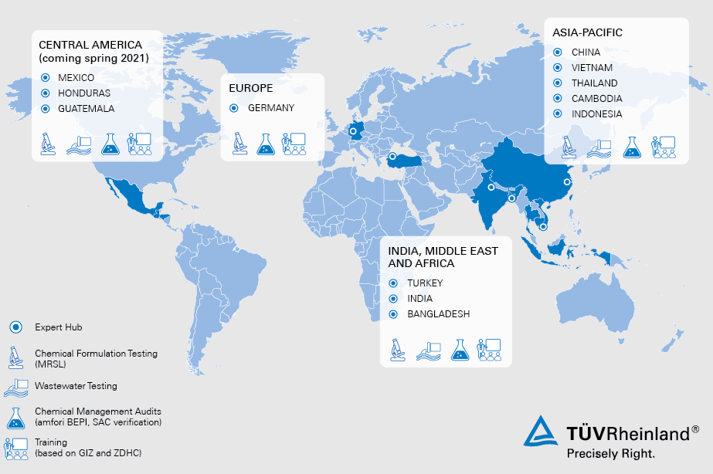
Your Local Partner
www.tuv.com/detox
Steffen.Tuemptner@de.tuv.com
Vietnam: Anh.Nguyen@tuv.com
China: Arrow.shi@tuv.com/carmen.yan@tuv.com
All Sustainability Topics Rakesh.Vazirani@tuv.com
Bangladesh: Fatema.Jahan@bd.tuv.com
India: venkat.hr@ind.tuv.com/ sesadev.pn@ind.tuv.com
Pakistan: Rashid.Mansoor@sa.tuv.com Akhlaq.Hussain@sa.tuv.com

Slide 32

DETOXing your supply chain
Our enabling services
Risk
assessment
Wastewater monitoring
MRSL
compliance checks of chemical inventory
Supplier
audits
Product RSL checks
Chemical management training

Slide 33
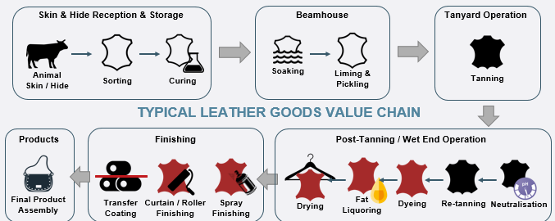
Notes:
The intended audiences are both management and environmental / chemical responsible in the tanneries and EHS managers of wet and finishing processing.
For environmental / chemical responsible, the training will help them to understand the harmful effects of hazardous chemicals used in tanneries and why and how the chemical management system is important in wet and finishing processing facilities,
For Management and EHS managers of wet and finishing processing facilities the training will support and empower you to initiate the process of establishing a chemical management system in their organization and provide general guidance on chemical management practice

Slide 34
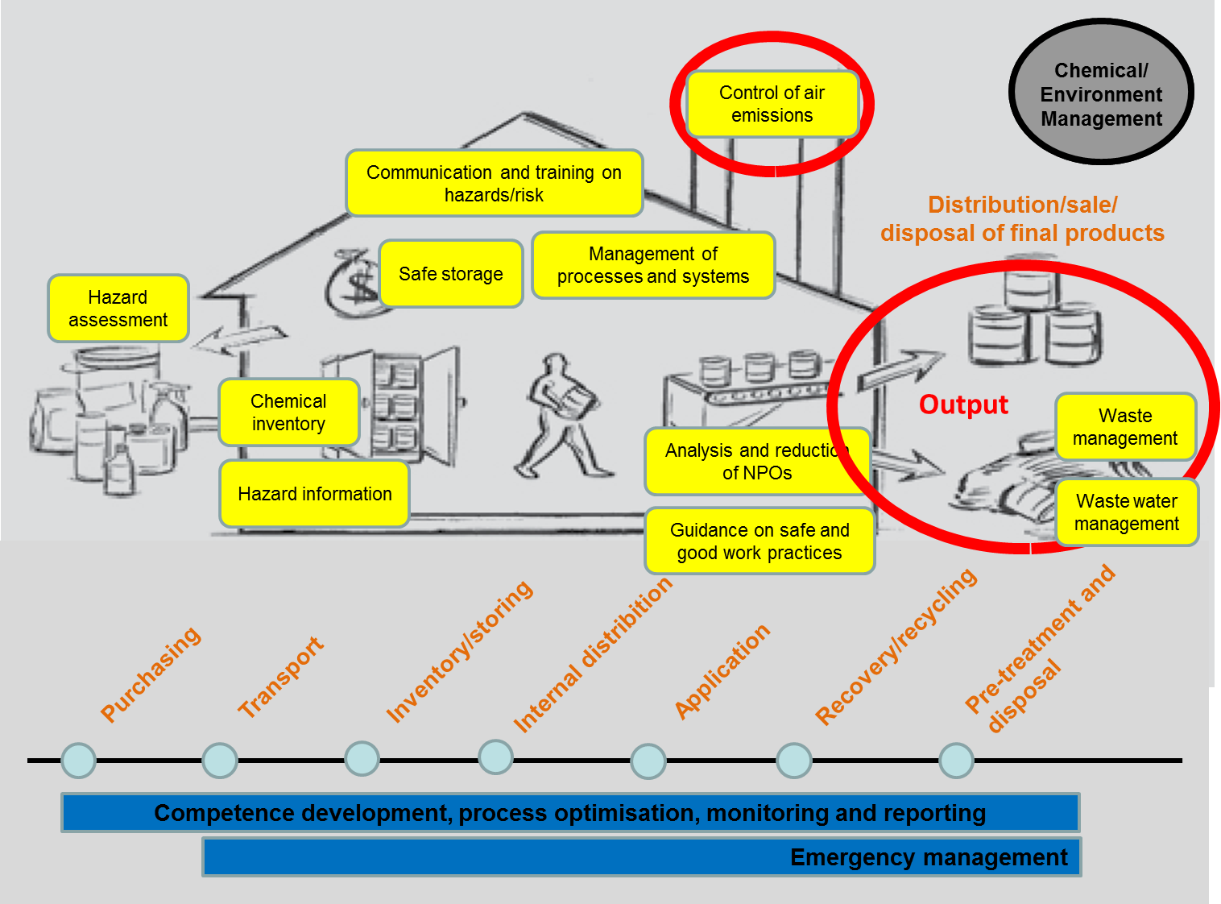
Chemical Management : Factory Level aspects {OUTPUT}
Source : giz REMC

Slide 35
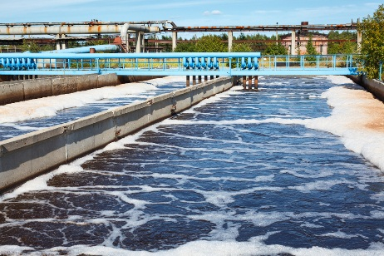
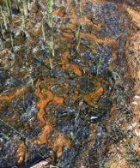

Environmental Exposure Pathways of
Hazardous Chemicals
Product
(possible chemical residue)
Tanning Factroy
Discard
Wastewater
Waste Gas
Solid Waste
Notes:
Hazardous Chemicals can also be exposed to the environmental across 4 main pathways:
Waste gases liberated to the air: Greenhouse gas emissions or liberation of formaldehyde and PFOA (from PFCs used in oil/water repellent finishes) during finishing treatment
Wastewater: All chemicals that are washed out during the different stages of manufacture i.e beamhouse, wet-end, dyeing, finishing in a typical tannery facility and discharged after suitable treatment to lower the pH, BOD, COD, TSS, temperature and other regulated values.
Solid waste: includes Sludge generated during the process of effluent treatment at primary and secondary stages, as well the waste products (such as flashings, trimmings, shavings, used chemical containers, etc) generated in the manufacturing plant.
Final Product: that is garment or upholstery or leather articles, which will contain residues of hazardous chemicals which can get washed out during simple home laundering, or which may leach out of the garment and leather goods when discarded into unsecured landfills.

Slide 36
Sampling Point Locations
Ground/Incoming Water (Without Treatment)
Wastewater Before Treatment
Wastewater After Treatment
Sludge
Please note that the places of sampling are usually four as mentioned above and may vary depending on the type of mills and also from brand to brand based on their internal strategy
Notes:
It is important to note that some facilities may not have all of these sampling points. Sampling and reporting will be adjusted accordingly.

Slide 37







MRSL > Brain of the ZDHC Programme
Brand/Retailer
Commitment
Trainings
Product/Process
Assessment
Tier2/
Wet Processing Mills
WasteWater
Parameters
ZDHC MRSL
Chemical Formulator
Conformance
Guidance
Notes:
Within the practice of effective chemical mgmt., we view the ZDHC MRSL as the brain of the entire system which guides and governs the overall ecosystem
With impact for Chemical Manufacturer, for the Tier2 mills, Brands/Retailers so as to decide function and performance features of garments that could be impacted, but also assessment organization that analyze chemical products of wastewater for conformance

Slide 38
Transition to New Approach for Textile/footwear Industry
DETOX and Possible Elimination Strategy
Do you know which chemicals are considered essential for your production and what are common finding as part of a plan to ensure consistent compliance?
Brands, Retailers have an increasing demand for safer product due to shift in market for Toxic free, sustainable and environmental-friendly products.
In order to meet with these increasing demands, for example products should contain less or no harmful substances.
Meetings this basic demand a manufacturers need to have robust systems in place to allow
Review,
Supervision,
Communication,
Design and
Manufacturing of safer products.

Slide 39
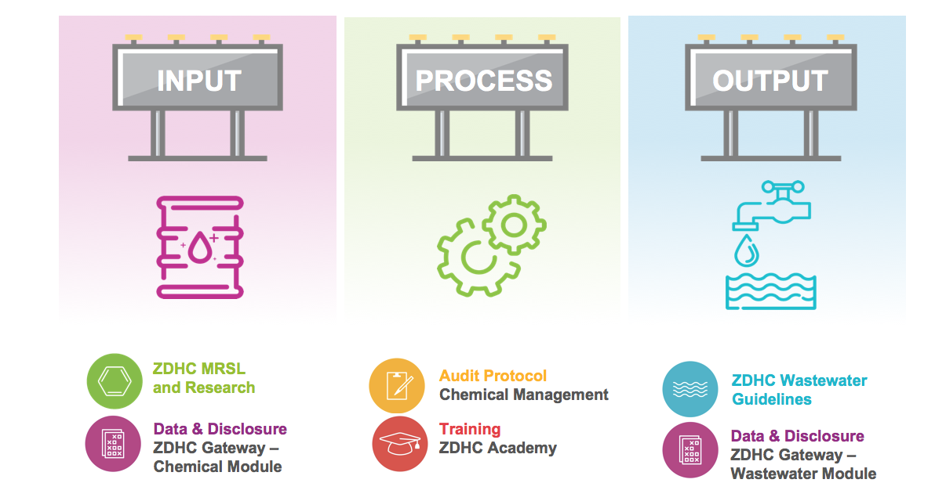
ZDHC Roadmap to Zero Programme: A holistic approach to sustainable chemical management

Slide 40






General information about ZDHC MRSL
A chemical substance is usually identifiable by a single,
unique Chemical Abstracts Service (CAS) number or Color index number(CI)
Difference between MRSL and RSL
AIR
The RSL governs the outputs (finished product) to protect consumers.
The MRSL governs the inputs to protect the environment, worker health and safety, and consumers.
ZDHC
MRSL
RSL
Raw Materials
Finished Product
WASTE WATER
WORKER HEALTH & SAFTEY

Slide 41
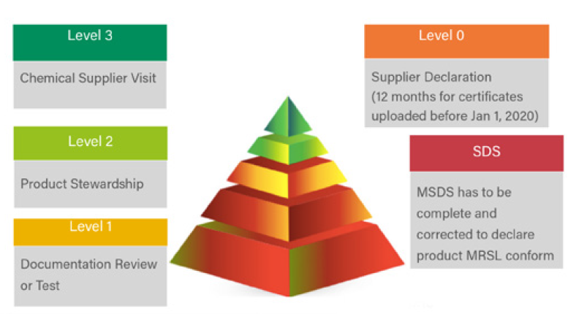
ZDHC MRSL Version 2.0 : Your road to the top
Higher conformance level means more extensive review of the chemical formulation and its producer.
ZDHC MRSL Conformance Guidance forms the backbone of the ZDHC Gateway - Chemical Module
Manufacturers and brands can use the ZDHC Gateway - Chemical Module to find ZDHC MRSL conformant safer alternatives.
Source : ZDHC
XXX
Notes:
MRSL Conformance Level 1 requires a third-party review of documentation or an analytical test report where the data meet the Quality Assurance and Quality Control requirements in Annex A to be accepted as evidence of conformance

Slide 42
ZDHC MRSL Management Team
ZDHC Strongly recommends involving the following Team :
EHS Manager to oversee the entire Chemical Management System
Effluent treatment Plant(ETP) Manger/Technician to provide insight and understanding of the impacts on effluent from Chemical Inputs
Product Quality Manager to ensure performance quality of the purchased Chemicals while ensuring compliance with the ZDHC MRSL
Operation/Production Manger to ensure the proper application of Chemicals ( For example nature, quantity) for the production of products
Purchasing/Procurement Manger/Officer to ensure alignment of Purchasing Chemicals in compliance with the ZDHC MRSL .
The above team members should work together and communicate regularly amongst themselves and factory Management

Slide 43
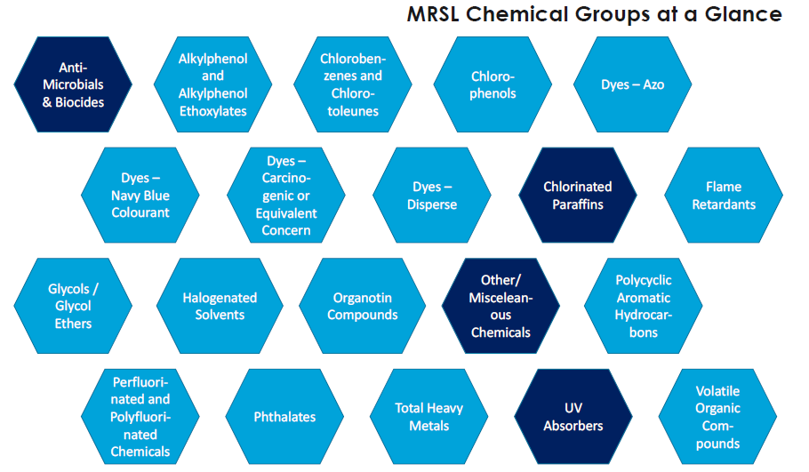

Slide 44
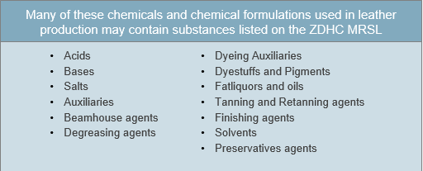
Types of Chemicals in Leather Supply Chain

Slide 45
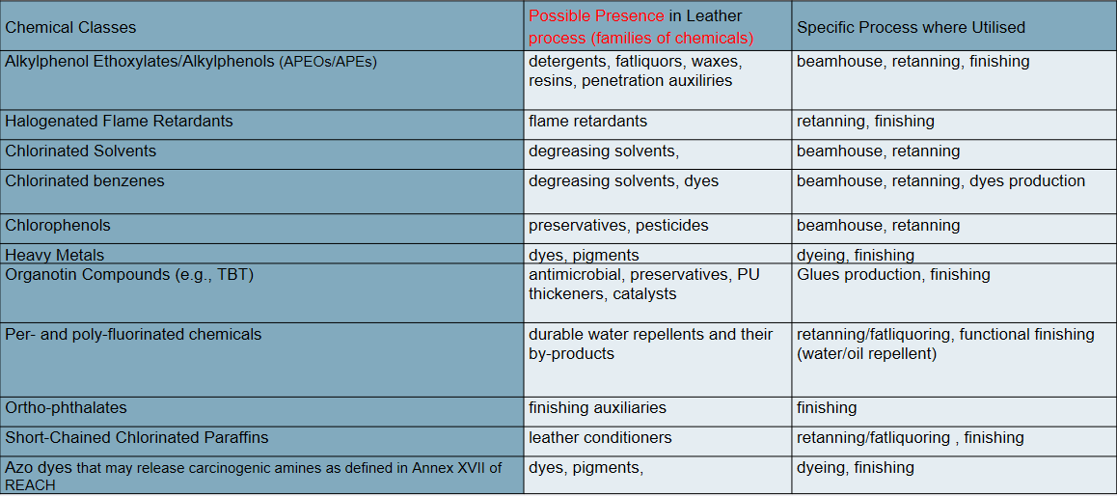
Classes of Priority Chemicals

Slide 46
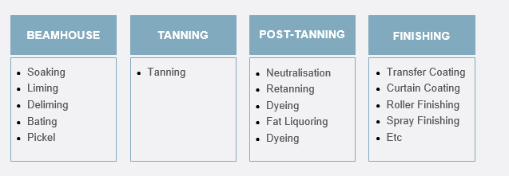
Chemicals used at each stage of Manufacturing Process

Slide 47
BIS – Footwear, Toys; New Era of Product Certification in India

Slide 48
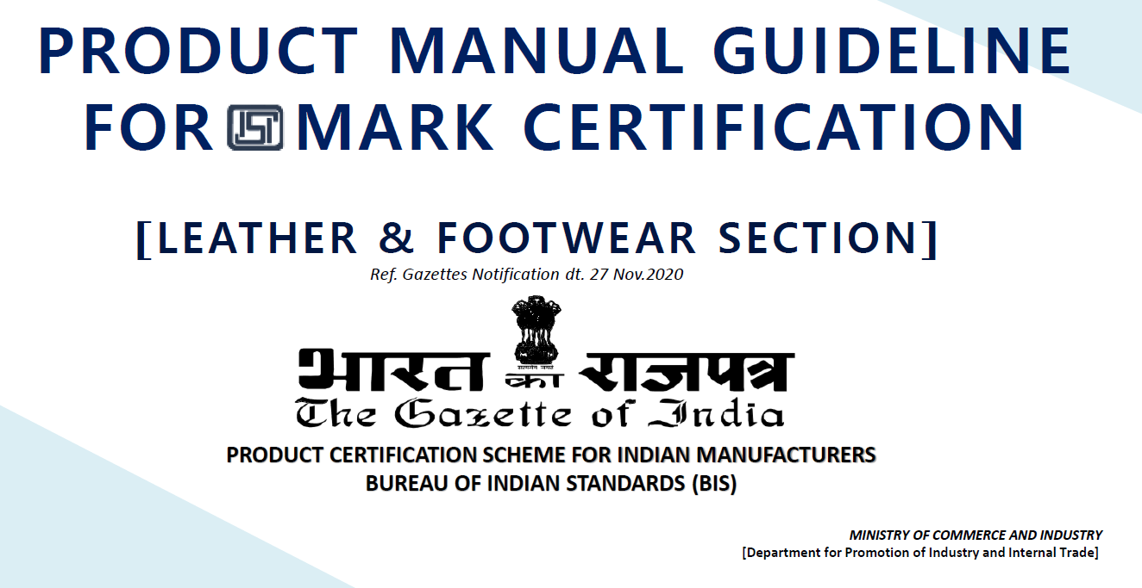

Slide 49
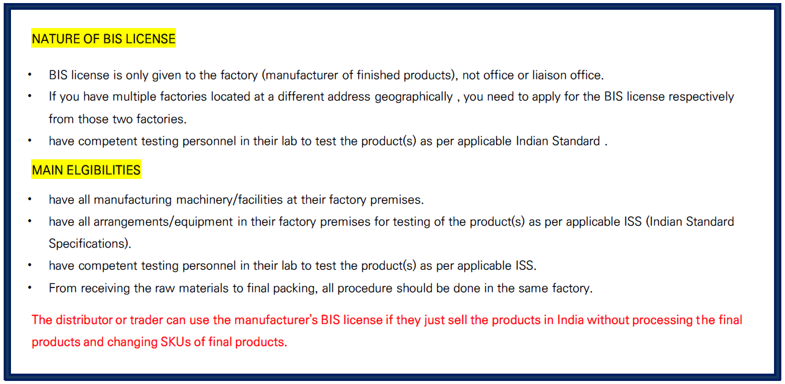
Whom it is applicable

Slide 50
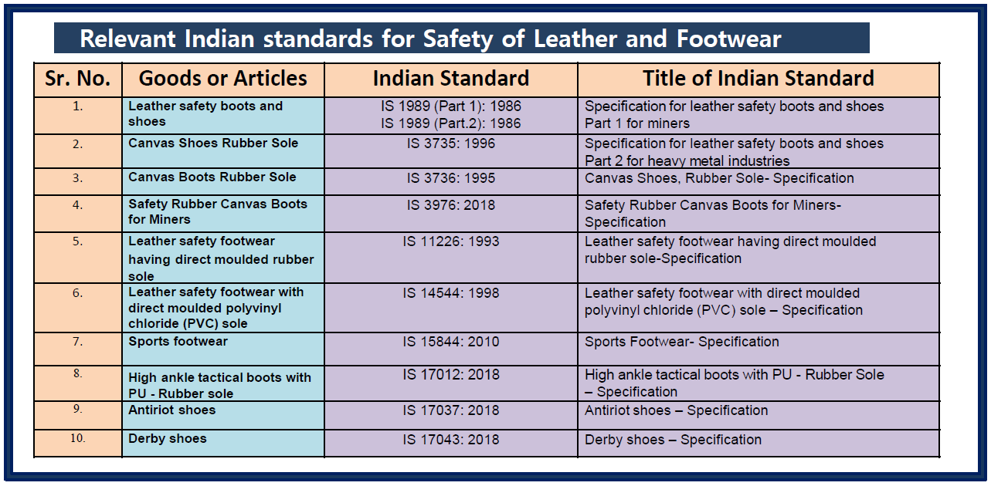
List of Mandatory Tests under the BIS Footwear QCO

Slide 51
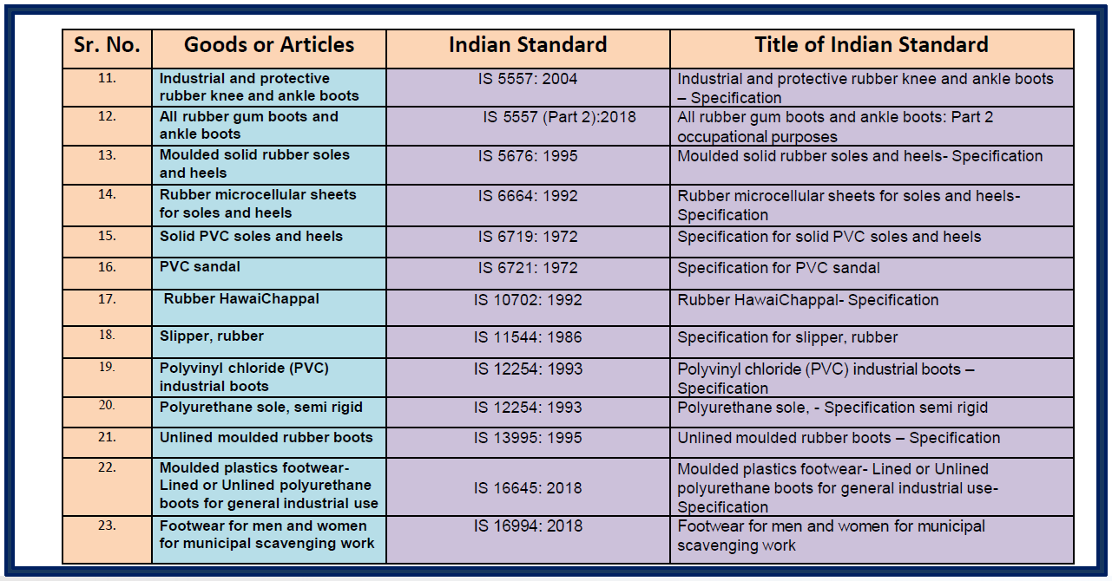
List of Mandatory Tests under the BIS Footwear QCO

Slide 52
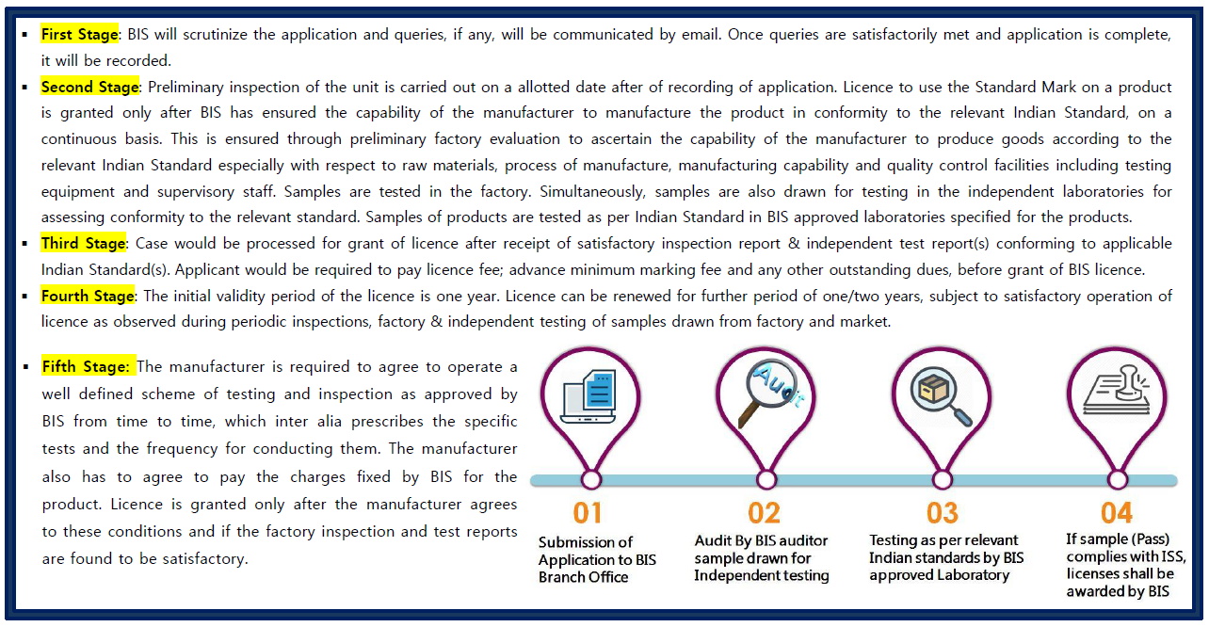
Procedure for Grant of License from BIS – Option 1

Slide 53
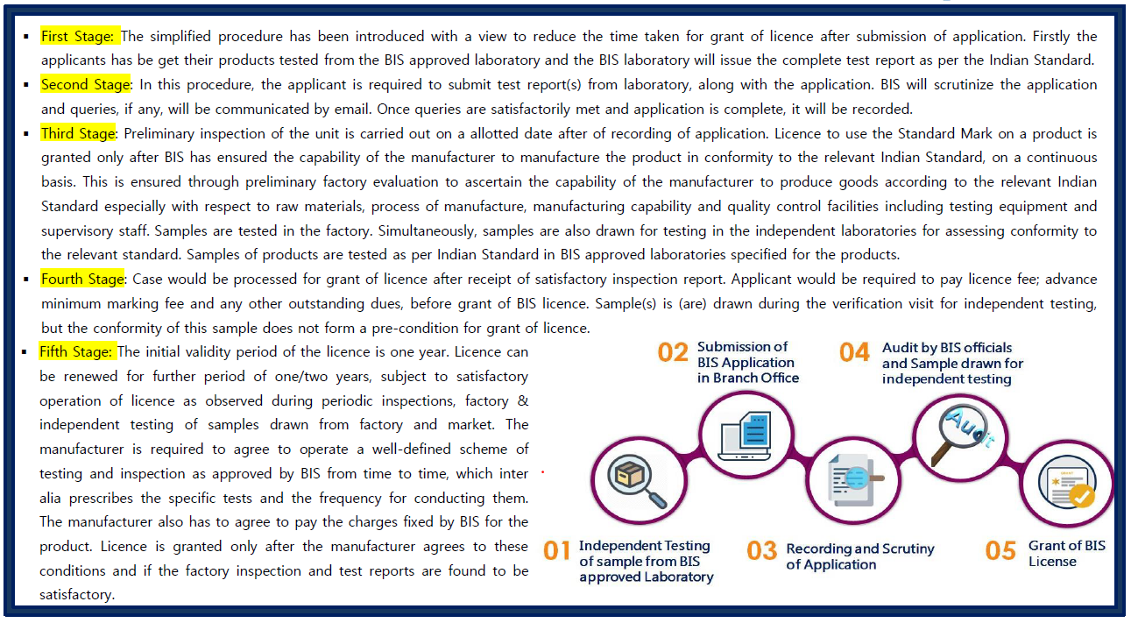
Procedure for Grant of License from BIS – Option 2

Slide 54
Update on our preparations for the BIS recognition for the Footwear testing
Our status with respect to BIS Footwear recognition is as below:
The recognition will be given if we have NABL accreditation for respective IS standard which is progress and We expect to secure the recognition from BIS is also in process
QCO | Test Standard | Test Name | Coverage | BIS Status
QCO -1 | IS 5676: 1995 | Moulded solid rubber soles and heels- Specification | Complete product covered | Expected recognition by BIS
QCO -1 | IS 6664: 1992 | Rubber microcellular sheets for soles and heels- Specification | Complete product covered | Expected recognition by BIS
QCO -1 | IS 6719: 1972 | Specification for solid PVC soles and heels | Complete product covered | Expected recognition by BIS
QCO -1 | IS 6721: 1972 | Specification for PVC sandal | Complete product covered | Expected recognition by BIS
QCO -1 | IS 10702: 1992 | Rubber HawaiChappal- Specification | Complete product covered | Expected recognition by BIS
QCO -1 | IS 11544: 1986 | Specification for slipper, rubber | Complete product covered | Expected recognition by BIS
QCO -1 | IS 13893: 1994 | Polyurethane sole, semirigid- Specification | Complete product covered | Expected recognition by BIS
QCO -1 | IS 13995: 1995 | Unlined moulded rubber boots :Specification | Complete product covered | Expected recognition by BIS
QCO-3 | IS 3735: 1996 | Canvas Shoes, Rubber Sole- Specification | Complete product covered | Expected recognition by BIS
QCO-3 | IS 3736: 1995 | Canvas Boots, Rubber Sole- Specification | Complete product covered | Expected recognition by BIS

Slide 55
Update on our preparations for the BIS recognition for the Footwear testing
Below are test where we have partial capability now. If we get business projection we can add these in future.
QCO | Test Standard | Test Name | Coverage | BIS Status
QCO -1 | IS 12254: 1993 | Polyvinyl chloride (PVC) industrial boots - Specification | Partial Capability | Expected recognition by BIS
QCO -1 | IS 16645: 2018 | Moulded plastics footwear- Lined or Unlined polyurethane boots for general industrial use- Specification | Partial Capability | Expected recognition by BIS
QCO-3 | IS 14544: 1998 | Leather safety footwear with direct moulded polyvinyl chloride (PVC) sole Specification | Partial Capability | Expected recognition by BIS
QCO-3 | IS 15844: 2010 | Sports Footwear- Specification | Partial Capability | Expected recognition by BIS
QCO-3 | IS 17043: 2018 | Derby shoes Specification | Partial Capability | Expected recognition by BIS

Slide 56
Update on our preparations for the BIS recognition for the Footwear testing
Below are Safety shoes details, if we get business projection we can add these in future.
QCO | Test Standard | Test Name | Coverage | NABL Status | BIS Status
QCO -1 | IS 5557: 2004 | Industrial and protective rubber knee and ankle boots - Specification | Not applied for Safety shoes | Not Applying | As such we have no request for Safety footwear hence we have not included
QCO -1 | IS 5557 (Part 2): 2018 | All rubber gum boots and ankle boots: Part 2 occupational purposes | Not applied for Safety shoes | Not Applying
QCO -1 | IS 16994: 2018 | Footwear for men and women for municipal scavenging work | Not applied for Safety shoes | Not Applying
QCO -2 | IS 15298 (Part 2): 2016 | Personal Protective equipment - Part 2 Safety Footwear | Not applied for Safety shoes | Not Applying
QCO -2 | IS 15298 (Part 3): 2019 | Personal Protective equipment - Part 3 Protective Footwear | Not applied for Safety shoes | Not Applying
QCO -2 | IS 15298 (Part 4): 2017 | Personal Protective equipment - Part 4 Occupational Footwear | Not applied for Safety shoes | Not Applying
QCO-3 | IS 1989 (Part 1): 1986 | Specification for leather safety boots and shoes Part 1 for miners | Not applied for Safety shoes | Not Applying
QCO-3 | IS 1989 (Part.2): 1986 | Specification for leather safety boots and shoes Part 2 for heavy metal industries | Not applied for Safety shoes | Not Applying
QCO-3 | IS 11226: 1993 | Leather safety footwear having direct moulded rubber sole-Specification | Not applied for Safety shoes | Not Applying
QCO-3 | IS 17012: 2018 | High ankle tactical boots with PU - Rubber Sole Specification | Not applied for Safety shoes | Not Applying
QCO-3 | IS 17037: 2018 | Antiriot shoes Specification | Not applied for Safety shoes | Not Applying

Slide 57

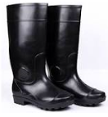
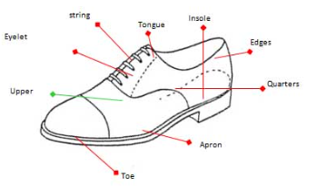
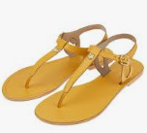

Footwear Services
Footwear and footwear components like
  Shoes, Safety Footwears, Safety Boots, Canvas Shoes, Sports wear Shoes, Sandals etc..
  Shoe uppers,
  Soles etc.,
Other Leather Products such as
  Leather garments,
  Leather gloves,
  Leather saddlery goods,
  Leather travel bags
  Leather purses,
  Wallets,
  Briefcases etc.
  Industrial leather items

Slide 58
Value Added Services
Single Point of Contact-
- Mr. Dhananjay Pandey ,Key Account Executive / dhananjay.pandey@ind.tuv.com /9599849292
For any service issues, please escalate to Manager-Customer Service (Mr. Manjeet Yadav @ +919899794272)
TAT – 3 working days
i- Pickup Facility
  Mumbai
  NCR
  Agra
  Kanpur
  Bangalore
  Ludhiana,etc
Supplier‘s Event- Lab Training, Season beginning
Technical Assistance- Failure Analysis (Repeated failure), Added tests
*Special Discount for all CLE Members

Slide 59
Time for Questions and Answers
Contact Details :
Siddhartha Srivastava
Sr. Manager- Business Development,
Footwear & Leather Products , Soft lines
Mob: 9599404006
Email: siddhartha.srivastava@ind.tuv.com

Slide 60

Thank you!

