Slide 1
COUNCIL FOR LEATHER EXPORTS
(Sponsored by Ministry of Commerce & Industry, Government of India)
Destination India - Footwear & Leather Products

Slide 2
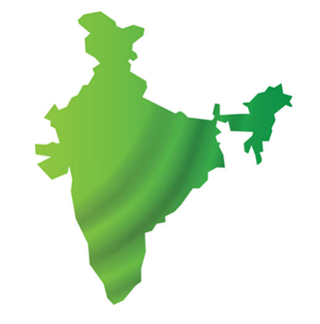
India – the Growth Epicenter
【1】
USD 1 Trillion FDI inflows since April 2000.
29% rise in FDI Apr. – Dec. 2024 as compared to 27% in Apr. to Dec. 2023.
⊰3⊱
【3】
3rd Largest Economy by PPP (GDP : 2024: USD 4.27 Tn)
6.4% GDP growth projection for 2025 (IMF).
【2】
2nd Largest Road & Rail Network (National Highways 1.46 lakh Kms)
Will be 2nd largest consumer market by 2030 – from 4th currently
Consumer Market to grow from USD 2.4 Tn in 2024 to USD 4.3 Tn in 2030
【11】
11 National Industrial Corridors being developed
11.3% CAGR growth in Private Final Consumption Expenditure (PFCE) in last 10 years
【67】
67% (986 Mn) of total population (1.46 Bn People) are in working age (between 15 & 64)

Slide 3
India – Focus on Sustainability
Global Ranking
3
3rd largest renewable Energy Producer (46.3% of energy capacity installed as of October 2024 (203.18 GW of 452.69 GW) coming from renewable sources). Target – 500 GW by 2030 (Under National Solar Mission)
Schemes
National Electric Mobility Mission
Targets
Reduction in 1 Bn Ton carbon emissions by 2030
Net Zero Emissions by 2070
45% Reduction in GDP emission intensity by 2030 from 2005 levels
4 / 5
4th largest Wind Energy Installed Capacity (50 GW in 2025), 77 % increase since 2014.
5th largest Solar Energy Installed Capacity (3450 % increase from 2.82 GW in 2014 to 100 GW in 2025).
National Green Hydrogen Mission
Afforestation & Green India Mission
Energy Conservation Building Code (to reduce fossil fuel consumption)
22% of national electricity generation is renewable (2024)

Slide 4
India – Frontrunner in Ease of Doing Business
World Bank Ease of Doing Business Ranking: 130 in 2016 to 63 in 2020
Lower Corporate Tax rate for new manufacturing companies (@15%)
Ease of Doing Business
+
Manufacturing Competitiveness
GST-Unified Taxation system
Digitalization-Company regn, tax filing, Obtaining licenses, etc,.
Competitive Utility Cost (Power & Water)
National Single Window
Access to 645 Central & 6113 State Government approvals
39,000 Compliances reduced
3rd Largest recipient of Greenfield projects as per World Investment Report 2023
Secured 39th Spot in Global Innovation Index 2024 among 133 countries – from 81st rank in 2015.
Competitive Incentive structure for Footwear and Leather Sector (Both Central and State Level)
4

Slide 5
Incorporation of a company in India
Types of Companies
Limited Liability Partnership
Private Limited
(Min. 2 & max 200 shareholders)
Limited
(Min. 7 share holders. No maximum limit) . Shares can be traded in stock exchange
Details of incorporation & Operation of a company

Slide 6
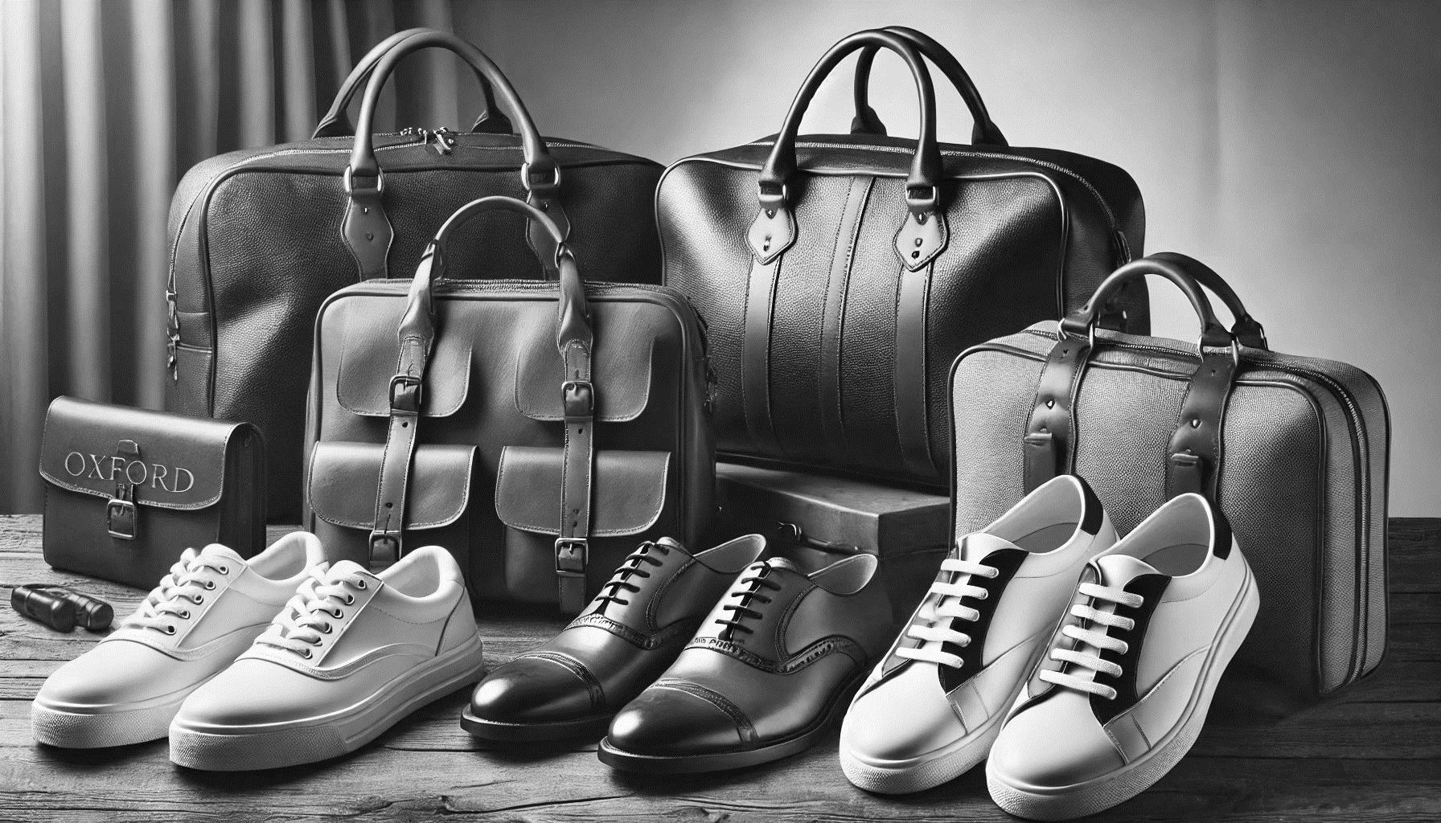
Indian Footwear & Leather Industry – Factsheet
Employment
Exports
Domestic Turnover
Share in Global Market
Tanning base
4.42 million
USD 5.7 billion* ( 2024-25)
USD 19 billion (2023 -24)
(Footwear – USD 17 Bn, Leather Products – USD 2 Bn)
2.28% ( 2024)
( Estimated Global Imports during 2024 : USD 250 bn)
13% share in Global Production. Hides/ Skins availability – 3 bn sq.ft in 2024
58.12 mn pcs bovine hides, 99.3 mn pcs goat skins, 44.37 mn pcs sheep skins
All tanneries connected to CETPs.
Zero Liquid Discharge (ZLD) adopted in many CETPs.
Leading Player in colour trends - 14 out of 28 selected colours at Modeurop and all 24 selected colours at Fashion Trend Pool for Spring /Summer 2025 were from India
EI (East India) tanned leather is a unique product of India.
* Includes non leather products under Chapter 42 – estimated value

Slide 7
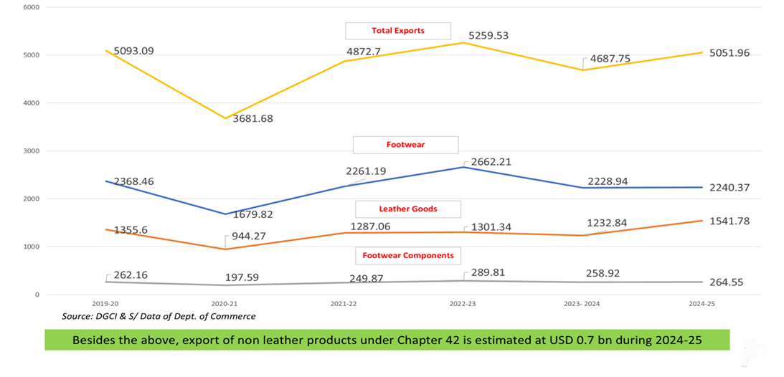
Export Trends – Last Five Years

Slide 8
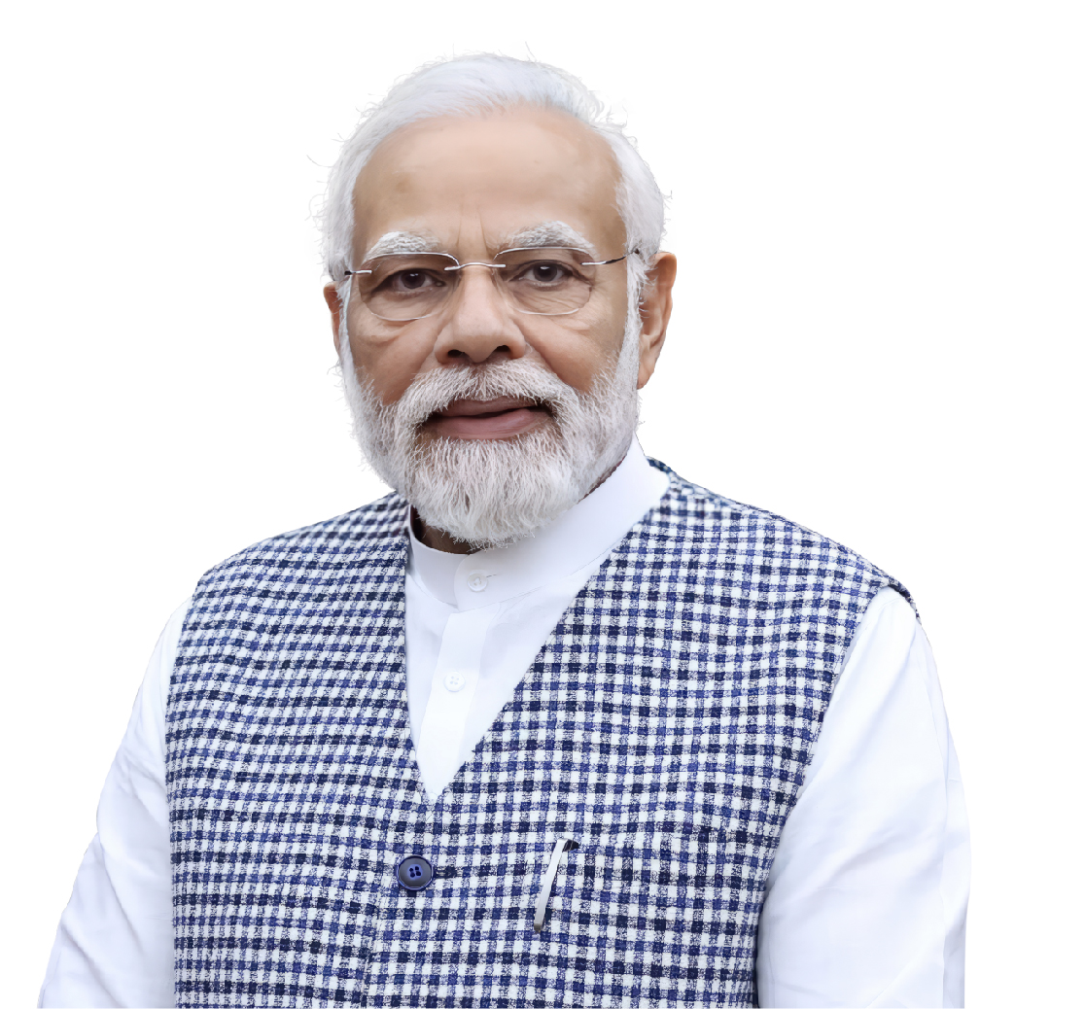
Vision set by Hon’ble Prime Minister (1/2)
Hon’ble Prime Minister Shri Narendra Modi envisions the Footwear and Leather sector as a priority sector for driving inclusive and export-led economic growth.
Vision for Footwear & Leather Sector rests on four strategic pillars:
an inclusive approach with new confidence that empowers social equity and enterprise of any scale and size;
a strong focus on manufacturing excellence for domestic market and export competitiveness;
expanding economic partnerships through free-trade agreements, technology transfers, and large scale investments (including FDI) and
creating global champions that embody India’s innovation, sustainability, quality, and craftsmanship on the global stage.
The Union Budget 2025–26's major support for the leather and footwear sector, including the Focus Product Scheme and duty cuts on leather exports and imports. These measures aim to boost production, employment, and exports significantly and aim to enhance India’s competitiveness globally and boost employment.

Slide 9
Vision 2030 (2/2)
Exports – 19.69% CAGR
Exports
Exports by 2030
Footwear- $ 7.6 Bn
Other Goods - $ 6.4 Bn
Domestic
$ 14 Bn
$ 36 Bn
$ 5.7 Bn
$ 19 Bn
Domestic Market by 2030
Footwear- $ 27.5 Bn
Other Goods - $ 8.5 Bn
Domestic Market –
13.63% CAGR
$ 24.7 Bn
$ 50 Bn
2024-25
2029- 30
Growth factors : Rise in disposable income, growing middle class, fashion awareness among youth and growth in consumer retail (E-Comm, D2C, etc.,) & huge export opportunities

Slide 10
Indian Footwear Industry – Snapshot (2023)
10
Production
Consumption
Exports
RANK | COUNTRY | PAIRS (MILLIONS) | WORLD SHARE | 3 YEAR CAGR
1 | CHINA | 3532 | 17.10% | -3.59%
2 | INDIA | 2563 | 12.41% | 8.51%
3 | USA | 1934 | 9.36% | 1.86%
4 | BRAZIL | 776 | 3.76% | 3.94%
5 | JAPAN | 616 | 2.98% | 1.79%
6 | PAKISTAN | 544 | 2.63% | 4.55%
7 | INDONESIA | 544 | 2.63% | -12.81%
8 | RUSSIA | 428 | 2.07% | 9.72%
9 | BANGLADESH | 355 | 1.72% | -0.92%
10 | MEXICO | 340 | 1.65% | 14.25%
 | RoW | 9023 | 56.32% | -3.59%
RANK | COUNTRY | PAIRS (MILLIONS) | WORLD SHARE
1 | CHINA | 8958 | 63.80%
2 | VIETNAM | 1335 | 9.51%
3 | INDONESIA | 445 | 3.17%
4 | GERMANY | 349 | 2.49%
5 | TURKIYE | 301 | 2.14%
6 | INDIA | 257 | 1.83%
7 | BELGIUM | 220 | 1.57%
8 | ITALY | 191 | 1.36%
9 | CAMBODIA | 165 | 1.18%
10 | SPAIN | 156 | 1.11%
 | RoW | 1664 | 11.85%
RANK | COUNTRY | PAIRS (MILLION) | WORLD SHARE
1 | CHINA | 12300 | 54.91%
2 | INDIA | 2600 | 11.61%
3 | VIETNAM | 1400 | 6.25%
4 | BRAZIL | 866 | 3.87%
5 | INDONESIA | 807 | 3.60%
6 | PAKISTAN | 561 | 2.50%
7 | TURKIYE | 502 | 2.24%
8 | BANGLDESH | 423 | 1.89%
9 | MEXICO | 217 | 0.97%
10 | IRAN | 176 | 0.79%
 | RoW | 2548 | 11.38%
Source: World Footwear Year-Book 2023

Slide 11
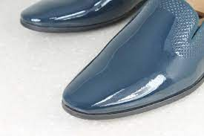
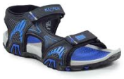
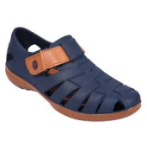
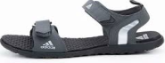
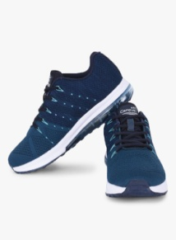
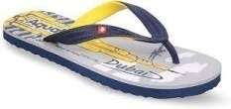
India – Footwear Market Size
Exports - Value
2.6 Billion pairs per annum
Production
PU Footwear
$17 Billion
Non - Leather Footwear categories & share of production
Sports Sandals
Domestic Market -Value
Domestic Market Size
EVA
$2.26 Billion
Exports
Sport Shoes
Hawaii

Slide 12
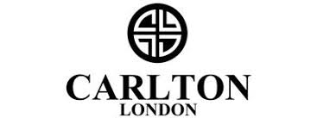
12
Indian Footwear Market – Market Segmentation & Pricing
India being price conscious market, Brands mainly catering to the mass market
% Share, Value
Price Segments
Brands
1%
Luxury
Rs. 12,000+(>140USD)
Premium
Rs.3,000 – 10,000
(36-120 USD)
6%
Mid
Rs.1,000 - 3,000
(12-36 USD)
10%
30%
Economy
Rs.500 – 1,400
(6-16 USD)
53%
Mass
<Rs.500
(<6 USD)
* Price is ASP for footwear for different brands
10

Slide 13
Opportunity India| Growth Potential
Footwear Sold per Person – Year : 2023
Top 10 Countries based on Pairs Consumed
Footwear sold per Person (Per Annum)
Brazil
China
Pakistan
Bangladesh
Indonesia
Russia
Mexico
USA
Japan
India
India’s per capita consumption is only 1.8, lowest amongst the top 10 countries. While China’s per capita consumption is 2.5
India`s per capita consumption is projected to grow to 4 pairs (2030) with consumption reaching 6 Bn Pairs.
Domestic footwear demand (leather & non leather) is expected to grow at 10% CAGR and reach $27.5 Bn by 2030 from the current size of $ 17 Bn
13

Slide 14
Components, Raw Materials & Inputs – Huge Opportunity
Value of raw materials/leather/components/inputs used in footwear & leather industry
( domestic & exports)
12.8 billion USD
(assuming total cost of components, inputs, leather & raw materials @ 65% of export value of USD 5.7 bn and domestic market factory sales value of USD 14 bn)
Components/ Inputs industry has huge growth potential in India
Textiles based footwear is amongst the highest growing segment.

Slide 15
Critical Raw Materials/ Inputs
S# | Material | Supply Chain | Import Duty for China
1 | PU (Poly Urethane coated Fabrics) HSN 56039490 59032090 | Annual Demand : 550 KT 73% (400 KT PA) imported. Major suppliers are China, Japan , Taiwan, Vietnam, USA and South Korea. Import during 2023 – 24 : HSN 56039490 : USD 31.13 million. HSN 59032090 : USD 98.88 mn | 20%
2 | EVA (Ethylene Vinyl Acetate) HSN : 39013000 | Annual Demand : 280 KT Import during 2023 – 24 : USD 383.99 mn. Major Suppliers are South Korea, Saudi Arabia, Taiwan. | 7.5%
3 | PVC (Poly Vinyl Chloride) HSN : 390410 | About 2040 Kilo Tons PA (57.82%). Imported from 51 countries. 5% to 7% used in footwear. Major suppliers are China, Japan and Taiwan. Import during 2023-24 was USD 2454.91 mn | 10%
4 | Footwear Components Uppers, Soles etc., HSN 6406 | Major suppliers are China, Vietnam, Hong Kong. Import during 2023-24 : USD 92.33 million. | 20%
5 | Metal Accessories HSN 8308 | Major suppliers are China, Hong Kong, Italy. Import during 2023-24 : USD 115.73 million. | 9%

Slide 16
Critical Raw Materials/ Inputs
S# | Material | Supply Chain | Import Duty for China
6 | Adhesive Tapes/ Sheets HSN 39199090 | Major suppliers are China, South Korea, USA. Import during 2023-24 : USD 537.42 million. | 15%
7 | Plastic Trims and buckles used for footwear including EVA sheets for soles, welts of plastic, plastic shoe lasts HSN 3926 | Major suppliers are China, Germany, Japan. Import during 2023-24 : USD 1183.31 million. | 15%
8 | PU, including water-based PU and Rubber 39095000 | Major suppliers are China, Singapore, Netherlands. Import during 2023-24 : USD 350.07 million. | 7.5%
9 | Non woven fabrics HSN 5603 | Major suppliers are China, Japan, Thailand. Import during 2023-24 : USD 193.03 million. | 20%
10 | Non-Wovens HSN 60063200 | Major suppliers are China, Taiwan, Vietnam . Import during 2023-24 : USD 277.47 million. | 16%
11 | Warp Knit Fabrics HSN 6005 | Major suppliers are China, Korea, Sri Lanka. Import during 2023-24 : USD 101.37 million. | 25%

Slide 17
Critical Raw Materials/ Inputs
S# | Material | Supply Chain | Import duty for China
12 | Eyelets HSN 73182300 | Major suppliers are China, Japan, Italy . Import during 2023-24 : USD 34.26 million. | 15%
13 | Threads HSN 54012000 | Major suppliers are Germany and China . Import during 2023-24 : USD 2.46 million. | 5%
14 | Threads HSN 52042090 | Major suppliers are Tanzania and China . Import during 2023-24 : USD 0.14 million. | 10%
15 | Rubber HSN : 40012100 | Major suppliers are Vietnam, Malaysia, Bangladesh. Import during 2023-24 : USD 55.65 million. | 20%
16 | Silica HSN 28112200 | Major suppliers are China, Belgium, Japan. Import during 2023-24 : USD 98.32 million. | 4.125%
17 | Imitation Leather Fabrics of Cotton HSN 59032010 | Major suppliers are Vietnam, China, Germany. Import during 2023-24 : USD 7.74 million. | 20%

Slide 18
Critical Raw Materials/ Inputs
S# | Material | Supply Chain | Import duty for China
18 | Toe Puffs HSN 35069110 | Major suppliers are Vietnam, China, Taiwan. Import during 2023-24 : USD 6.91 million. | 10%
19 | Labels/ Badges HSN 58071020 | Major supplier is China. Import during 2023-24 : USD 2.07 million | 10%
20 | Cartons HSN 48191010 | Major suppliers are China, Sri Lanka, Vietnam. Import during 2023-24 : USD 17.23 million. | 10%
21 | Mechanically made lace (man made fibre) HSN 58042100 | Major suppliers are China, Sri Lanka, Hong Kong. Import during 2023-24 : USD 15.43 million. | 20% or Rs.200 per KG whichever is higher
22 | Mechanically made lace (Other textile materials) HSN 580429 | Major suppliers are China, Hong Kong, Indonesia. Import during 2023-24 : USD 17.41 million. | 10% or Rs.200 per KG whichever is higher

Slide 19
Machinery – Investment Opportunity
Huge scope for setting-up machinery unit in India, as 98% of the tanning machinery and 95% of the footwear and products machinery are imported.
Import of machinery into India – Million USD
HSN | Type of Machinery | 2023-2024
84531000 | Machinery for preparing, tanning or working hides, skins or leather | 10.23
84532000 | Machinery for making or repairing footwear | 39.87
84538000 | Other machinery | 7.72
84539010 | Parts of boot and shoe manufacturing machinery | 1.80
84539090 | Other parts of machinery | 15.13
 | Total | 74.75
HSN | Type of Machinery | 2023-2024
8477 | Machinery for working rubber or plastics or for the manufacture of products from these materials, not specified or included elsewhere in this Chapter | 1406.98
8452 | Sewing Machines | 279.05
Import duty for China - 7.5%
Import duty for China - 6.37%
(84521011 to 84521029 and 845230 & 84772000)
Import duty for China - 7.5%
( Other machinery under 8477 and 8452)

Slide 20
Footwear Moulds – Investment Opportunity
Good Quality and new designs moulds are mostly imported.
Precision mould making needs to be developed as there are only small factories
Moulds for rubber/plastics - Import data - 84807100
Million USD : 2023-24
Moulds for rubber/plastics - Import data - 84807900
Million USD : 2023-24
Country | Import | % share in import | Import duty
China | 160.92 | 44.94% | 6.37%
Korea | 118.10 | 32.98% | 0%
Germany | 16.77 | 4.68% | 7.5%
Total | 358.05 | 100.00%
Country | Import | % share in import | Import duty
China | 186.09 | 69.90% | 7.13%
Korea | 10.91 | 4.10% | 0%
Japan | 7.43 | 2.79% | 0%
Total Import | 266.21 | -- | --

Slide 21
Growth & Investment Opportunities
Opportunities for Growth
Significant domestic demand projected, with 6 billion footwear pairs needed by 2030.
Substantial export potential in non-leather footwear, with current exports at only USD 350 million.
Access to skilled labor at competitive prices.
Growth prospects for the entire ecosystem.
Supportive policies from the Government of India and state governments.
Ease of Doing Business
Online self generation of Bank Realisation Certificate for export payments.
24 x 7 Customs Clearance.
E – sealing of export containers
PM Gati Shakti Portal with G.I.S Mapping for Multimodal connectivity
Authorised Economic Operator Programme (AEO) – Faster Customs clearance
National Logistics Policy for Freight Reduction Control and Dedicated Freight Corridor Operations.
Investment Opportunities
FDI – Both in Greenfield & Brownfield
Establish 3 Ms i.e. Machine, Manufacturing & Moulds
Huge scope for Make in India and Make for the world
Significant growth potential in athletic/ athleisure, ladies & Children footwear.

Slide 22
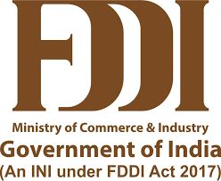
Skilling & Supporting Institutions
FDDI
LSSC
NIFT
Institute of National Importance for education in Leather & Footwear Sector with 12 Campuses
Skill council to support in labor workforce training/ skilling for Leather & Footwear Sector
Premier Institute for designing and management courses for Leather & Footwear Sector
CLRI
CFTI
Provide short and medium term skill training for Leather & Footwear Industry Workforce
Research, Development and Innovation in Leather & Footwear Sector
50 Occupational Standards and Qualification Packs developed for various job roles by LSSC for training
Skilling support provided by both Central Govt. (PMKVY and PM Vishwakarma) & State Governments
More than 3 lakh candidates trained via short-term courses, RPL, and upskilling initiatives.
5 lakh more unemployed youth to be trained & employed in next 5 years.

Slide 23
23
Government Schemes/Benefits (Existing)
Export Related Benefits
GST Rates & Corporate Taxes
IFLDP Scheme*
FDI Regulations
Scheme with outlay of USD 200 mn
Modernization of Units: USD 59 mn
Enviornment Management: USD 59 mn
Cluster Development: USD 35 mn
Institutional Support: USD 24 mn
Design Studio: USD 11.5 mn
Promotion of Brands: USD 11.5 mn
MAIS & TIES
RODTEP :
Finished leather: 1.3%
Leather Goods: 1.1% Footwear: 1.2%/0.9%
Duty Free Imports of notified raw materials through Advance Authorization & IGCR
EPCG Scheme - Duty Free Imports of Machinery
100% Repatriation of profits
100% FDI through automatic investment route
FDI in Retailing:
Single Brand: 100% Automatic Route
Multi Brand: 51% Automatic Route
Duty Free Shops: 100% FDI Automatic Route
GST:
Leather : 12%
Footwear Components, Leather Goods and Leather Garments: 18%
Footwear (Until Rs. 1,000/-): 12%/ Others : 18%
Corporate Tax: Competitive Rate of 15%
*IFLDP Scheme – Indian Footwear & Leather Development Program

Slide 24
Proposed Focus Product Scheme for Footwear & Leather Sector
24
5. Sustainability, Innovation and Testing/Certification
1. Operational Efficiency (OE)/ Localisation-Investment-Turnover-Employment (LITE) Incentive
01
Support research in environmental compliance, circular economy initiatives, research & development (R&D), sustainable innovation, enhancing testing infrastructure and meeting sustainability testing and certification requirements.
Incentive for meeting investment thresholds, driving incremental turnover, generating cumulative employment, and advancing localisation efforts.
02
05
2. Cap-Ex Incentive
Incentive to develop world-class state-of-art PM Foot Forward (PMFF) Parks, upgrading existing manufacturing units and clusters,.
4. Brand Promotion &
Market Linkage
Strengthen market access, boost exports, showcase Indian products and strengthen market linkage in order to promote Brand Bharat at global level for Footwear & Leather Sector.
03
3. Skilling Incentive
Training and upskilling of 5 Lakh workforce and promoting industry ready on-the-job training.
04
Co-eligibility with Other Schemes
This scheme is an additive in nature and the applicant can also avail benefits of other Central Government and State Government schemes

Slide 25
25
Products to be covered under Focus Product Scheme
Non-Leather Products
Leather Products
Chemicals
Non-Leather Footwear
Non-Leather Products such as Bags, Harness, Saddlery, Belt, Wallets, Gloves, etc.,
Raw Material (including Polyurethane (PU), Ethylene Vinyl Acetate (EVA), Thermoplastic Polyurethane (TPU), Webbing, PU Foam, EVA Foam, Gel, Rubber, Plastic, etc.,)
Components (including Moulds, Outsole, Insole, Heel Cap, Eyelets, Lace, Welt, Metal Components, etc.,)
Finished Leather
Leather Footwear
Leather Goods
Leather Garments
Leather Gloves
Saddlery & Harness
Accessories
Components (including various items including Moulds, Outsole, Insole, Heel Cap, Eyelets, Lace, Welt, Foam, Filler, Zips, Studs, Billets, Snaps, Metal Components, etc.,)
Chemicals related to Footwear & Leather sector.
Machinery
Footwear and Leather Goods machinery on complete knock down (CKD) basis and assembling.

Slide 26
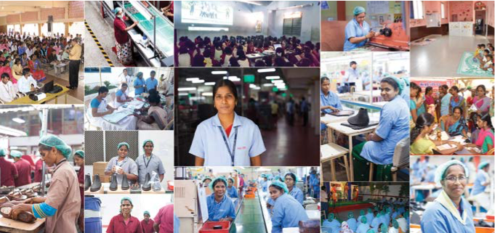
THANK YOU!

Slide 27
Incorporation of a company in India
1
Obtain Digital Signature Certificate (DSC) through authorized agencies. Address proof required.
2
3
4
5
Obtain Director Identification Number (DIN) through Ministry of Corporate Affairs (MCA) portal. Address proof required.
Reserve Company Name in MCA's portal. Once the name is approved, it remains reserved for 20 days from the date of approval.
Draft the Memorandum of Association (MoA), Articles of Association (AoA)
File Form SPICe (Simplified Proforma for Incorporating Company Electronically) - INC-32, Form INC-33 (e-MoA) and Form INC-34 (e-AoA) if applicable, Declaration by directors and subscribers, Address proof, identity proof, and photographs of directors and subscribers
Pay the Fees online
Upon verification and approval, the Registrar of Companies issues a Certificate of Incorporation

Slide 28
Factory establishment requirements
1
Allotment of land in industrial estate (for Govt)
6
Registration of Principal Employer Establishments for Employing Contractual Workmen . Registration of Principal Employer Establishments for Employing Inter-State Migrant Workmen
7
MSME Certificate ( for Micro, Small and Medium Enterprises)
2
3
4
5
Property registration
Planning Permission for factory building, Fire License, Electrical Safety Inspection, Power & Water connection, Approval for lifts and Escalator
Permanent Account Number (PAN) and Tax Deduction and Collection Account Number (TAN) from the Income Tax Dept. Import – Export Code (IEC) from DGFT.
Open a bank account and deposit the initial share capital. Register with Employees Provident Fund, Employees State Insurance Corporation .
Consent to Establish and Operate from State Pollution Control Board .
Obtain Consent to Operate from State Pollution Control Board .

Slide 29
Repatriation of profits of foreign companies from India
1
Investment : Foreign investors can invest in Indian companies, including those engaged in priority industries or involved in export and trading activities.
2
3
4
5
Profit Generation: The investments generate profits, which may include dividends, interest, or capital gains from the sale of shares.
Taxation: These profits are subject to taxation in India according to the relevant tax laws.
Repatriation: After paying taxes, the remaining profits and capital gains can be repatriated back to the investor's home country.
Authorized Dealer Banks: This process is typically facilitated through authorized dealer banks in India, which can convert the Indian currency into the investor's home currency for remittance.

Slide 30
Special Economic Zones (SEZ)
For setting up units in existing SEZs, approvals given by a Committee headed by Development Commissioner of the SEZ.
Can import inputs, raw materials, machinery & spares without any import duty and GST
Sales in the domestic market subject to payment of full custom duty, GST and import policy in force.
100% FDI is allowed in setting up of SEZs.
Approval for setting up of new SEZs is given by Department of Commerce, Government of India.
Units in SEZs have to be a net foreign exchange earner but they are not subjected to any pre-determined value addition or minimum export performance requirements.

Slide 31
Setting-up of tannery in India
1
Consent to establish and Consent to operate license from the State Pollution Control Board
2
3
4
To have Effluent Treatment Plant (ETP) or connected to Common ETP for discharge of effluents.
Authorization for handling hazardous waste is to be obtained from the State Pollution Control Boards. This includes activities like generation, processing, treatment, packaging, storage, transportation, use, collection, destruction, conversion, offering for sale, transfer, and disposal. Authorizations are granted are typically valid for 5 years.
Ministry of Environment, Forest & Climate Change, Govt. of India prescribes the standards for discharge of effluents from the tannery industry.
Treated Effluent | Max.Permissible Values (In mg/l,except for pH)
pH | 6 to 9
Biochemical Oxygen Demand (BOD3 at 27*C) | 20
Chemical Oxygen Demand (COD) | 250
Total Suspended Solids (TSS) | 50
Total Dissolved Solids (TDS) | 2100
Sulphides (as S) | 2.0
Total Chromium (as Cr) | 2.0
Hexavalent Chromium (as Cr+6) | 0.1
Oils and Grease | 10

